Slide 1

Asset Allocation Strategy Project
Daria Mustafina

Slide 2
Outline
Project Goal
Steps
Strategy Backtesting and portfolio performance evaluation
Conclusions
Further Steps

Slide 3
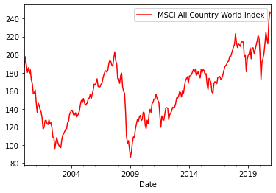
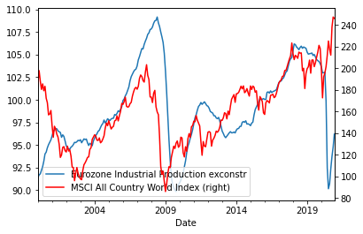
Project Goal
Optimal asset allocation is a common problem within asset management
The goal of the asset allocation strategy is to decide whether we should be long(buy), neutral(no position) or short(sell) on equity markets over the next month.
Notes:
Decision concerning optimal asset allocation is a common problem within asset management.
In this assignment I will develop an asset allocation strategy to decide whether you should be long(buy), neutral(no position) or short(sell) on equity markets over the next month.
To elaborate, at the end of each month, based on the information available in the features, would it be profitable to buy, sell or be neutral on the equity index?
To elaborate, at the end of each month, based on the information available in the features, would it be profitable to buy, sell or be neutral on the equity index

Slide 4
Steps
Exploratory data
Feature Selection
Feature Engineering
Machine Learning Index Forecasting Asset Allocation Strategy
Strategy Backtesting and Portfolio Performance evaluation
Conclusions
Further steps

Slide 5
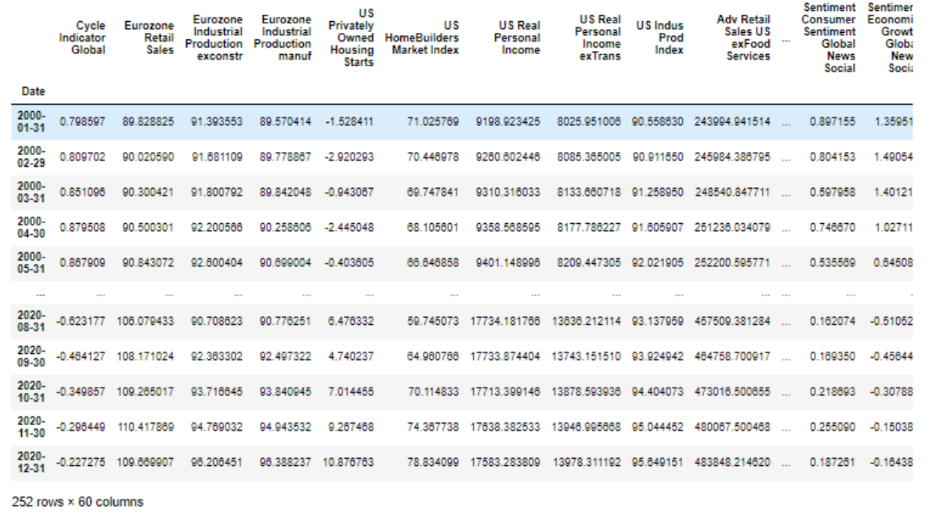
Data set
Monthly multivariate feature set (Jan 2000 – Dec 2020) , including various indicators (economic, technical, sentiment etc.) that are considered drivers of global equity market.
MSCI All Country World Index (widely used index of global equity markets).
Notes:
The data set represents a monthly multivariate feature set (Jan 2000 – Dec 2020) , including various indicators (economic, technical, sentiment etc.) that are considered drivers of the global equity market. Sheet named “Index” contains the MSCI All Country World Index (widely used index of global equity markets). Sheet “Features” contains the rest of the data. The Exploratory Data Analysis is done in order to prepare the data to use for index forecasting based on features.
contains rest of the data. You are free to select any method you like to identify important features and construct an allocation model.

Slide 6
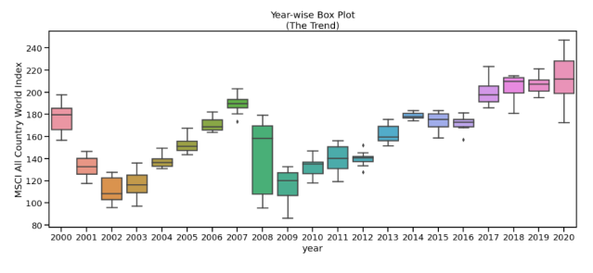
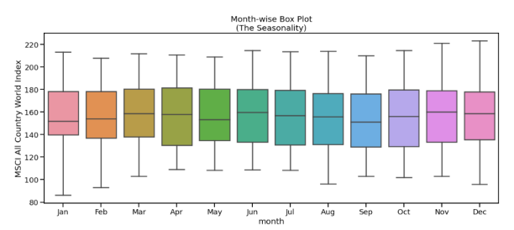
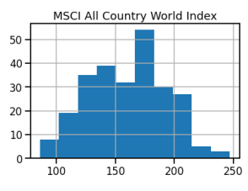
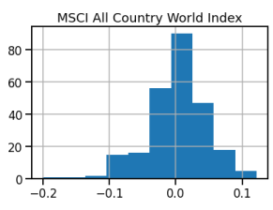
Exploratory Data Analysis
Insight | Significance test | Transformation
Skewed data |  | Feature Engineering
Structural breaks | Chow Test | Data Split
Seasonality
Index Value
Index percent change, %

Slide 7
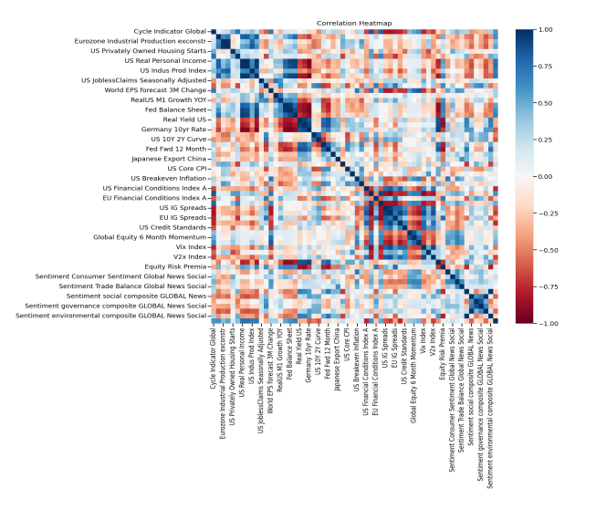
Feature Selection
Feature 1 | Feature 2 | Correlation Coefficient
US Real Personal Income | US Real Personal Income exTrans | 0.993794
Eurozone Industrial Production manuf | Eurozone Industrial Production exconstr | 0.984108
Sentiment environmental composite GLOBAL News | Sentiment environmental composite GLOBAL News Social | 0.972994
Fed Balance Sheet | FED Excess Reserves | 0.971247

Slide 8
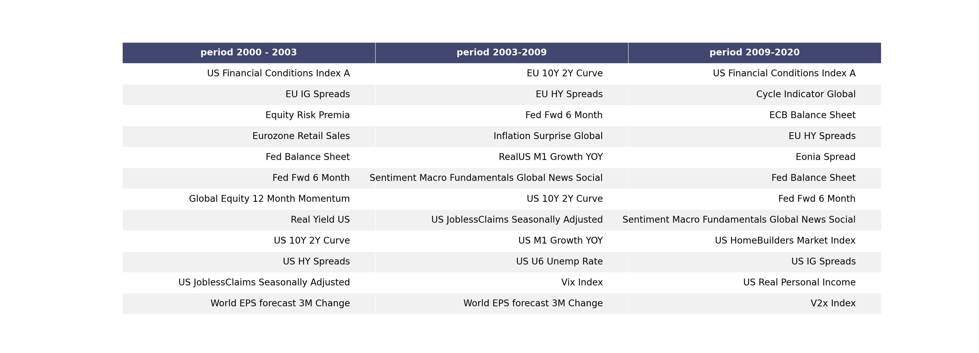
Feature Importance
Boruta Algorithm Feature Importance

Slide 9
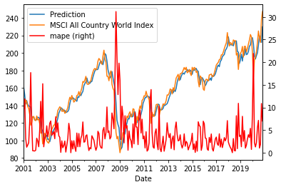
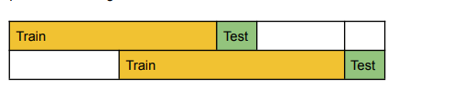
Modeling
Regression model
Metrics: MAPE
Random Forest

Slide 10
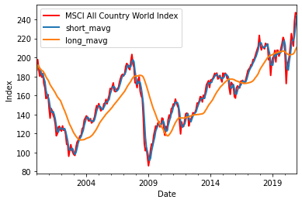
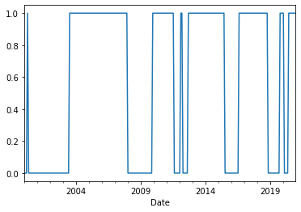
Asset Allocation Strategy
As an asset allocation strategy moving average crossover is implemented.
The predicted index value is used for calculating the moving averages for the next month and create buy/hold/sell signal depending on the moving averages (long moving average < short moving average = sell signal, short < long = buy signal, the rest is hold).
Backtesting of buy/hold/sell signal using historical index value, calculating returns and portfolio metrics are done and reported to Html file.
Notes:
Common Trading Strategies
From the introduction, you’ll still remember that a trading strategy is a fixed plan to go long or short in markets, but much more information you didn’t really get yet; In general, there are two common trading strategies: the momentum strategy and the reversion strategy.
Firstly, the momentum strategy is also called divergence or trend trading. When you follow this strategy, you do so because you believe the movement of a quantity will continue in its current direction. Stated differently, you believe that stocks have momentum or upward or downward trends, that you can detect and exploit.
Some examples of this strategy are the moving average crossover, the dual moving average crossover, and turtle trading:
The moving average crossover is when the price of an asset moves from one side of a moving average to the other. This crossover represents a change in momentum and can be used as a point of making the decision to enter or exit the market. You’ll see an example of this strategy, which is the “hello world” of quantitative trading later on in this tutorial.
The dual moving average crossover occurs when a short-term average crosses a long-term average. This signal is used to identify that momentum is shifting in the direction of the short-term average. A buy signal is generated when the short-term average crosses the long-term average and rises above it, while a sell signal is triggered by a short-term average crossing long-term average and falling below it.
Turtle trading is a popular trend following strategy that was initially taught by Richard Dennis. The basic strategy is to buy futures on a 20-day high and sell on a 20-day low.
Secondly, the reversion strategy, which is also known as convergence or cycle trading. This strategy departs from the belief that the movement of a quantity will eventually reverse. This might seem a little bit abstract, but will not be so anymore when you take the example. Take a look at the mean reversion strategy, where you actually believe that stocks return to their mean and that you can exploit when it deviates from that mean.
That already sounds a whole lot more practical, right?
Another example of this strategy, besides the mean reversion strategy, is the pairs trading mean-reversion, which is similar to the mean reversion strategy. Whereas the mean reversion strategy basically stated that stocks return to their mean, the pairs trading strategy extends this and states that if two stocks can be identified that have a relatively high correlation, the change in the difference in price between the two stocks can be used to signal trading events if one of the two moves out of correlation with the other. That means that if the correlation between two stocks has decreased, the stock with the higher price can be considered to be in a short position. It should be sold because the higher-priced stock will return to the mean. The lower-priced stock, on the other hand, will be in a long position because the price will rise as the correlation will return to normal.
Besides these two most frequent strategies, there are also other ones that you might come across once in a while, such as the forecasting strategy, which attempts to predict the direction or value of a stock, in this case, in subsequent future time periods based on certain historical factors. There’s also the High-Frequency Trading (HFT) strategy, which exploits the sub-millisecond market microstructure.

Slide 11
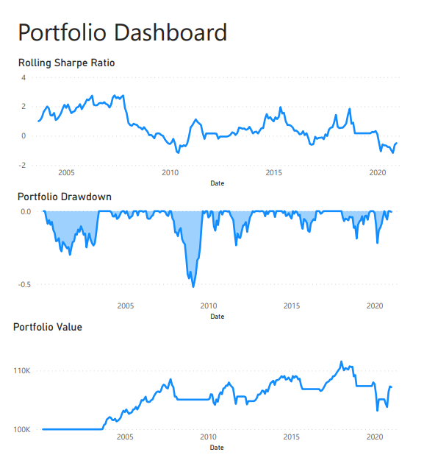
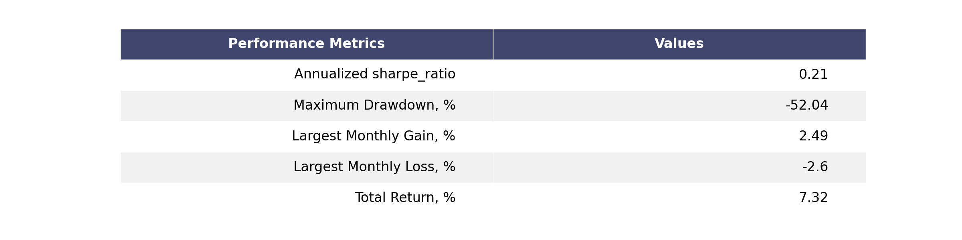
Strategy Backtesting and portfolio performance evaluation
Portfolio performance evaluation shows that model based on predicted values outperforms the model based on real historical index values
Portfolio performance is poor in terms of total return 7.6%
Sharpe ratio of 0.21 is reasonable
Maximum Drawdown 52% is acceptable

Slide 12
Conclusions
Information in the features can be used for one-month ahead prediction with MAPE = 4.1% for the data timeframe.
Highly correlated features like Fed Balance Sheet/Fed Excess Reserves can be replaced with one feature
Features that are important for index prediction are different for different periods (for example, Fed Balance Sheet after 2008 crisis), that is why the sliding training data is used to retrain the model.
Moving average crossover asset allocation model was implemented using index prediction one month ahead to predict moving averages crossover
Portfolio performance evaluation shows that model based on predicted values outperforms the model based on real historical index values. Overall the portfolio performance is poor in terms of total return (7.6%), sharpe ratio (0.21), and drawdown (-52%). The benchmarking with buy and hold strategy should be done for more precise evaluation.

Slide 13
Further Steps
Feature Engineering (lagged data, aggregated and averaged data, difference economic periods/cycles, previous index price information)
ML model tuning and optimization (historical index data used for training, recent data has higher weights than older data)
Testing other algorithms like QRF, ANN and in combination with Time Series Algorithms
Strategy optimization in terms of long and short windows based on portfolio performance metrics
Testing and benchmarking different buy/sell strategy

